Slide 1
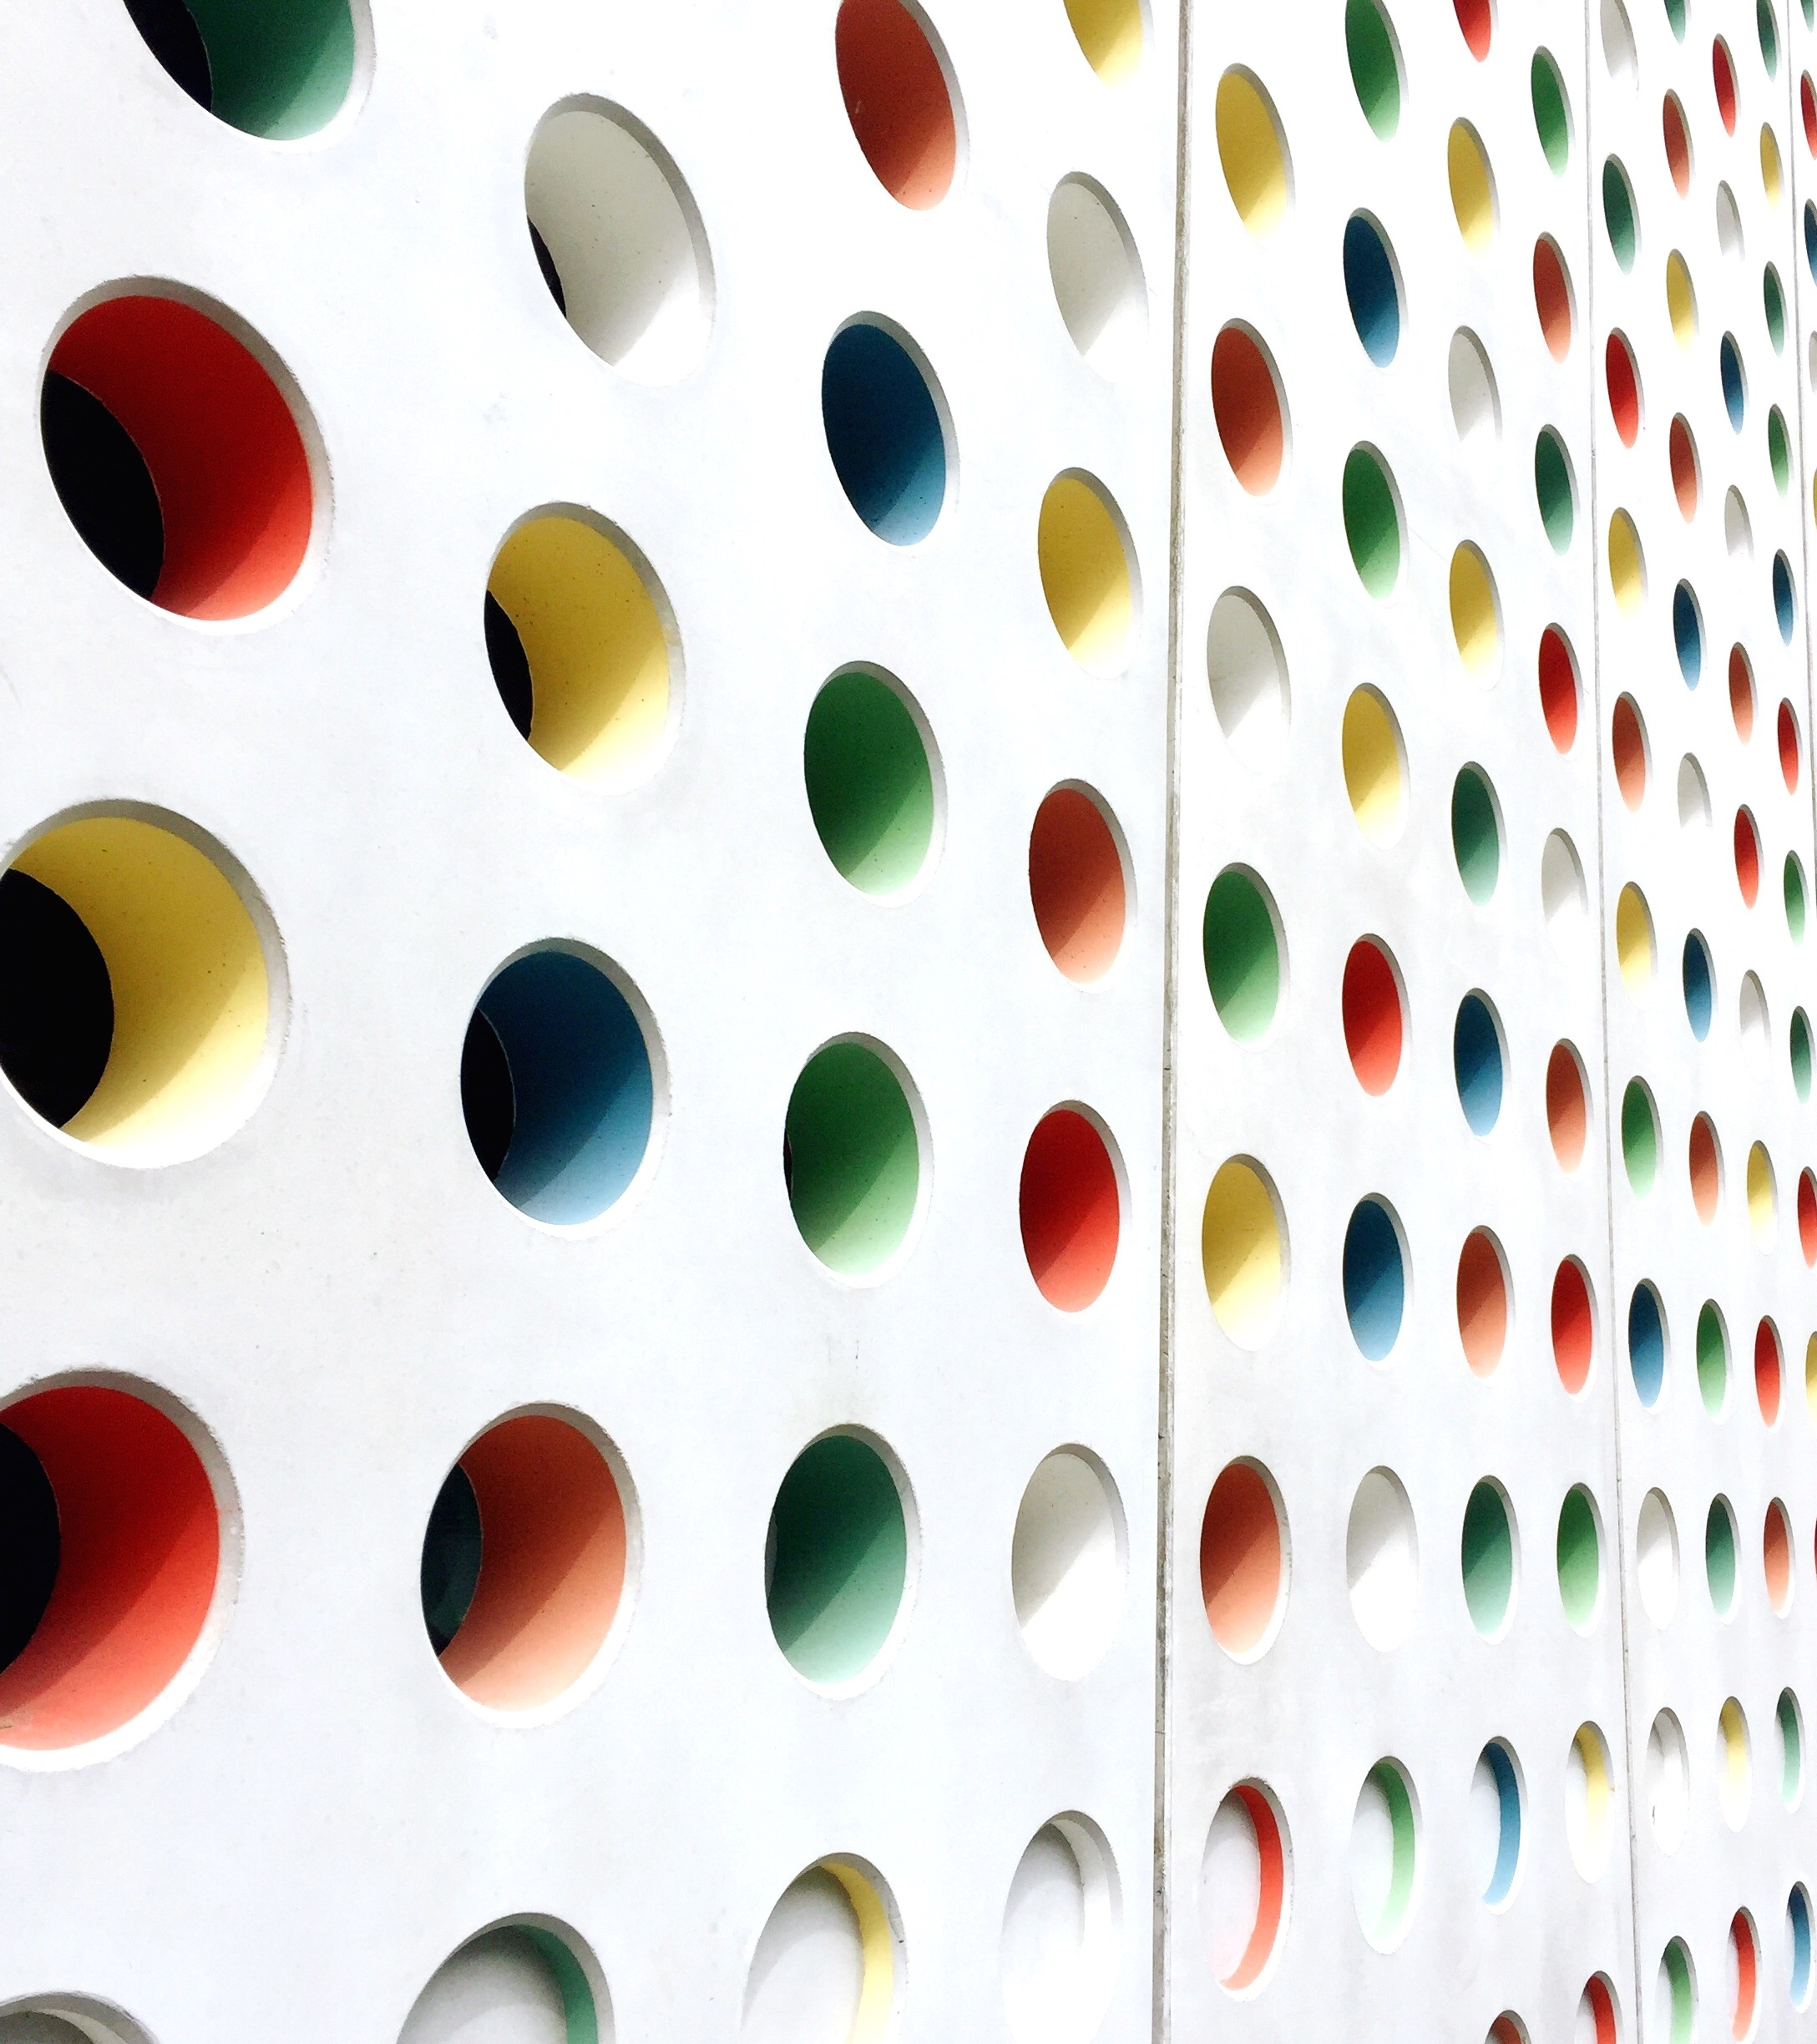
How to improve the livability of some Oklahoman cities
Hernan Fernandez

Slide 2
BUSINESS CASE
Study of the top-100 cities to live in the us according to livability.com
Extracting relevant results for Oklahoma city, tulsa and Stillwater, ok.
Matching our studied cities to similar top-100 cities and learn from them

Slide 3
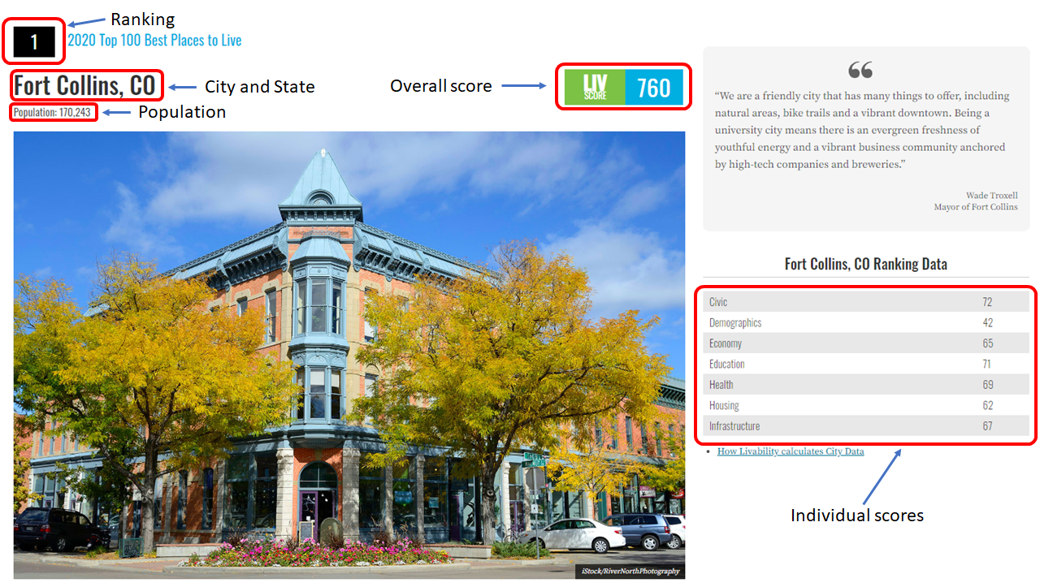

DATA ACQUISITION
Obtain data from livability.com’s Top 100 Best Places to Live¹
Extract venue information from each city using FourSquare API²
Extract venue information from Oklahoma City, Tulsa, and Stillwater.
Cleaning of outliers and non-relevant information.
https://livability.com/best-places/top-100-best-places-to-live/2020
https://developer.foursquare.com/

Slide 4
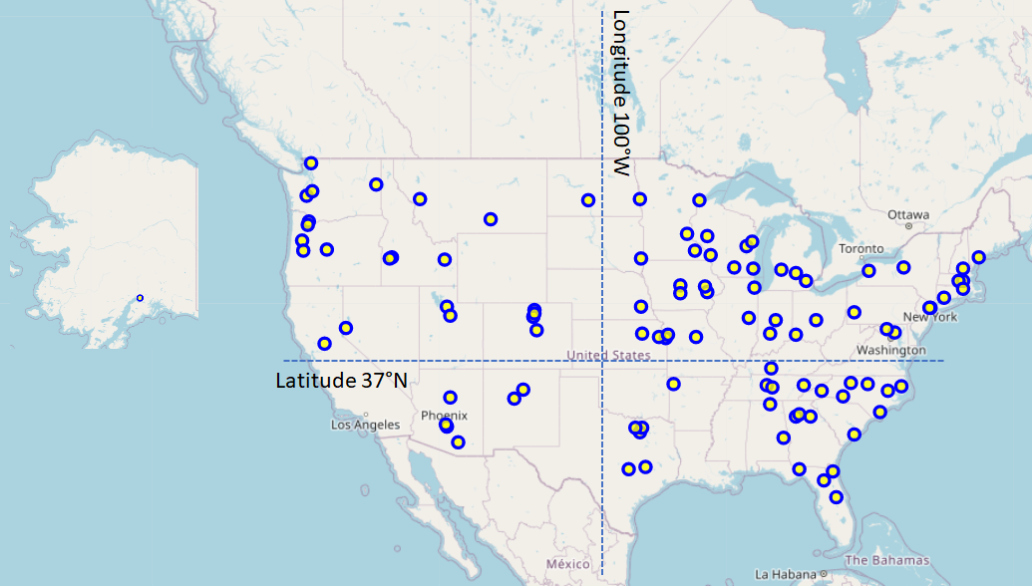
DATA ANALYSIS
Most cities in the Top-100 are located East of the 100°W meridian (70), and North of the 37°N parallel (67)
Livability.com data
Venue data
City clustering
Oklahoman cities

Slide 5
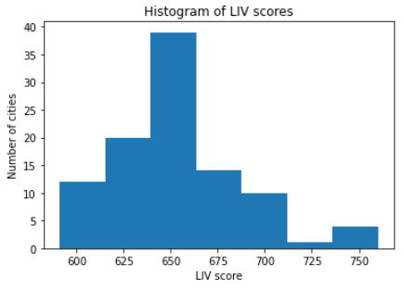
DATA ANALYSIS
Oklahoma is one of the 9 states without a representative in the Top-100
The Livability scores are somewhat normally distributed around 650
Livability.com data
Venue data
City clustering
Oklahoman cities
Top 100 cities | States
6 | Wisconsin
5 | North Carolina, Texas, Washington
4 | Arizona, Colorado, Florida, Iowa, Oregon
3 | Georgia, Idaho, Kansas, Michigan, Minnesota, New York, South Carolina, Tennessee
2 | Alabama, Illinois, Indiana, Maryland, Massachusetts, Missouri, Montana, New Mexico, North Dakota, Ohio, Utah
1 | Alaska, Arkansas, California, Connecticut, Kentucky, Maine, Nebraska, Nevada, New Hampshire, New Jersey, Pennsylvania, Rhode Island, South Dakota
0 | Delaware, Hawaii, Louisiana, Mississippi, Oklahoma, Vermont, Virginia, West Virginia, Wyoming

Slide 6
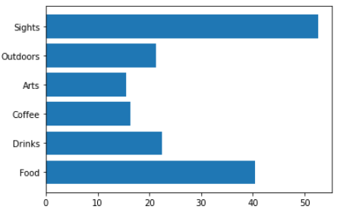
DATA ANALYSIS
The average Top-100 city center (750m radius) has 168 venues distributed in the following major categories:
Top-3 cities for each kind of venue:
Livability.com data
Venue data
City clustering
Oklahoman cities
53
21
15
16
23
40
Food
Sacramento, CA (76)
Charleston, SC (71)
Columbia, SC (71)
Drinks
Wilmington, NC (58)
Des Moines, IA (57)
Orlando, FL (54)
Coffee
Champaign, IL (48)
Sacramento, CA (40)
Bellingham, WA (37)
Arts
Santa Fe, NM (56)
Charleston, SC (42)
Grand Rapids, MI(41)
Outdoors
Columbia, MD (67)
Columbus, OH (66)
Providence, RI (60)
Sights
Asheville, NC (99)
Boise, ID (97)
Santa Fe, NM (92)

Slide 7
DATA ANALYSIS
K-Means with k=4 used to group all Top-100 cities based on their venue category makeup. Groups vs Average City
Coffee Cities (#26, Tempe, AZ)
Sightseeing Cities (#1 Fort Collins, CO, #3 Madison, WI, #7 Fargo, ND)
Vibrant Cities (#6 Asheville, NC, #10 Columbus, OH)
Peaceful Cities (#5 Rochester, MN, #9 Sioux Falls, SD)
Livability.com data
Venue data
City clustering
Oklahoman cities
Cluster # | Number | Food | Drinks | Coffee | Arts | Outdoors | Sights
0 | 5 | -12 | +3 | +20 | +0 | -8 | -27
Cluster # | Number | Food | Drinks | Coffee | Arts | Outdoors | Sights
1 | 28 | +9 | +7 | -1 | +1 | +1 | +16
Cluster # | Number | Food | Drinks | Coffee | Arts | Outdoors | Sights
2 | 12 | +25 | +16 | +8 | +21 | +24 | +33
Cluster # | Number | Food | Drinks | Coffee | Arts | Outdoors | Sights
3 | 42 | -11 | -10 | -4 | -5 | -6 | -18

Slide 8
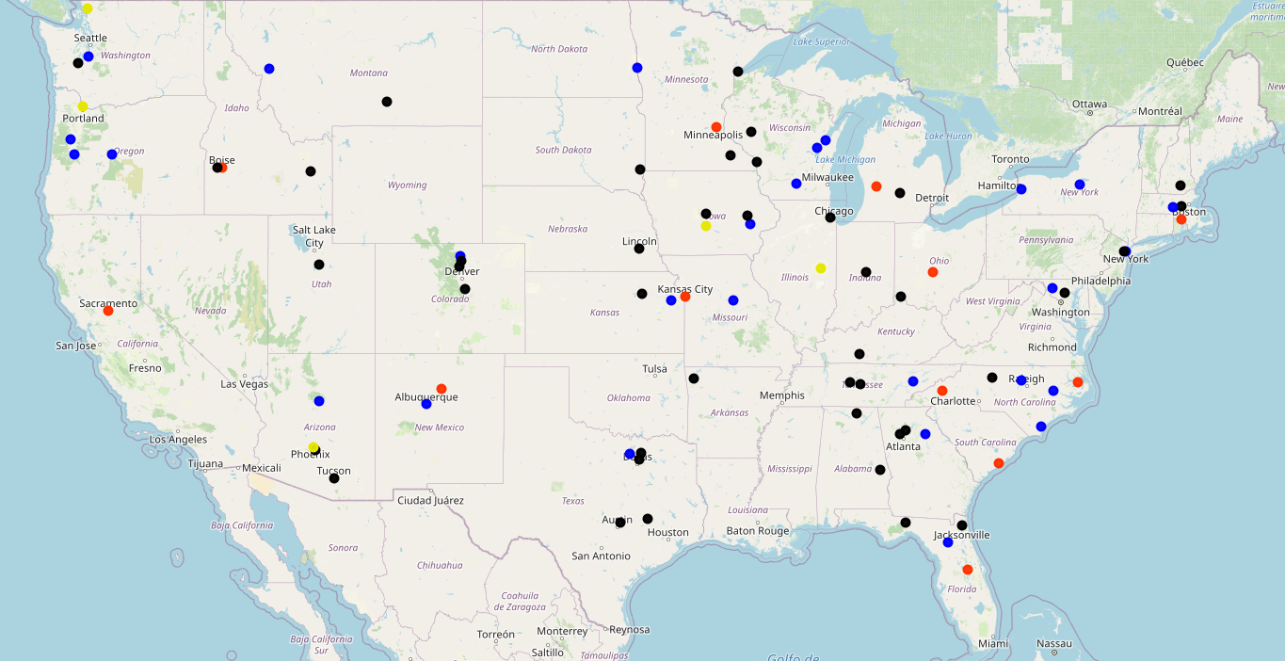
Sightseeing Cities
Coffee Cities
Peaceful Cities
Vibrant Cities

Slide 10
DATA ANALYSIS
K-Nearest Neighbors used to assign Oklahoma City, Tulsa and Stillwater to a cluster. K=3
Livability.com data
Venue data
City clustering
Oklahoman cities
OKLAHOMA CITY
Food | 59
Drinks | 33
Coffee | 14
Arts | 26
Outdoors | 38
Sights | 74
Total | 244
SIGHTSEEING CITIES
Food | 49
Drinks | 30
Coffee | 15
Arts | 16
Outdoors | 22
Sights | 69
Total | 201
TULSA
Food | 53
Drinks | 35
Coffee | 11
Arts | 15
Outdoors | 32
Sights | 94
Total | 240
STILLWATER
Food | 13
Drinks | 5
Coffee | 16
Arts | 16
Outdoors | 9
Sights | 25
Total | 84
PEACEFUL CITIES
Food | 29
Drinks | 13
Coffee | 12
Arts | 10
Outdoors | 15
Sights | 35
Total | 114

Slide 11
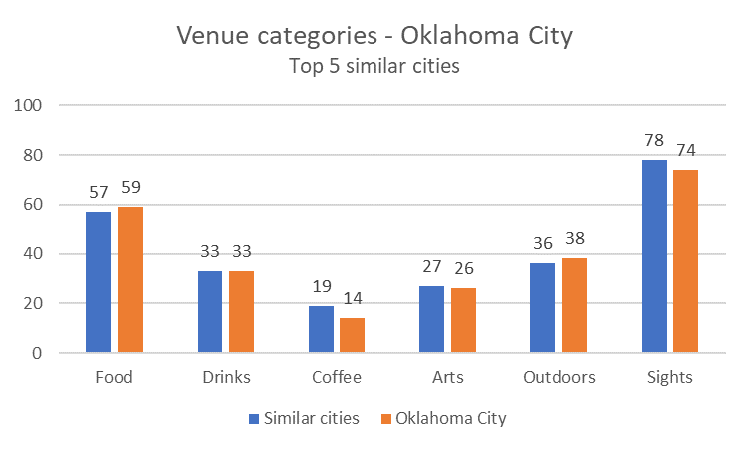
DATA ANALYSIS
Cosine Similarity to identify the most similar cities to OKLAHOMA CITY
Livability.com data
Venue data
City clustering
Oklahoman cities
#35 Boise, ID
#48 Charleston, SC
#75 Tacoma, WA
#89 Buffalo, NY
#96 Knoxville, TN
Estimated LIV score: 631 | Estimated Ranking: #69

Slide 12
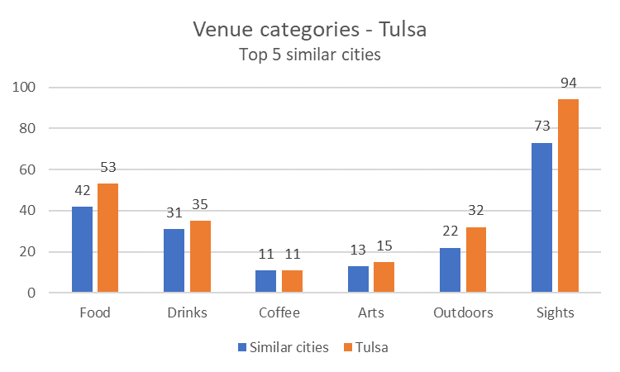
DATA ANALYSIS
Cosine Similarity to identify the most similar cities to TULSA
Livability.com data
Venue data
City clustering
Oklahoman cities
#7 Fargo, ND
#20 Missoula, MT
#35 Appleton, WI
#49 Greenville, SC
#67 Gainesville, FL
Estimated LIV score: 662 | Estimated Ranking: #36

Slide 13
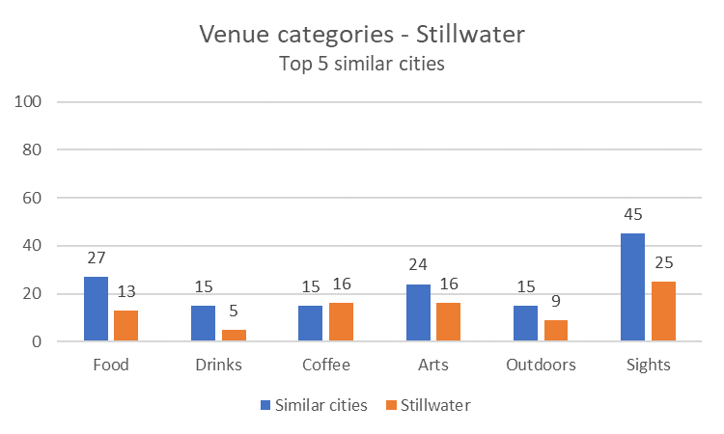
DATA ANALYSIS
Cosine Similarity to identify the most similar cities to STILLWATER
Livability.com data
Venue data
City clustering
Oklahoman cities
#65 Pflugerville, TX
#75 Duluth, MN
#83 Pflugerville, TX
#88 Santa Fe, NM
#95 Huntsville, AL
Estimated LIV score: 616 | Estimated Ranking: #81

Slide 14
DISCUSSION
Oklahoma City and Tulsa have great prospects of making the Top 100 in the future based on the above-average number of venues conforming their City Centers as compared to the current Top 100 Cities.
Stillwater should follow the example of the so-called Peaceful Cities, such as Rochester, MN (#5) and Sioux Falls, SD (#9), which have overcome their lower number of venues to become successful cities.
Tulsa should learn from Fargo, ND (#7), as it has managed to achieve excellence with a very similar venue-offer.
Oklahoma City should seek advice on city officials of Fort Collins, CO (#1) and Madison, WI (#3) as members of the same cluster of Sightseeing Cities.

Slide 15
CONCLUSION
The present study has successfully characterized the city centers of the Top 100 Cities to Live in the US selected by Livability.com.
Using machine learning techniques such as K-Means and K-Nearest Neighbors, we have been able to cluster all these cities along with the Case Study cities of Oklahoma City, Tulsa and Stillwater. As a result, we have identified Stillwater as a “Peaceful City”, and Oklahoma City and Tulsa as a “Sightseeing Cities”.
Future study on the top exponents of these groups (i.e. Fort Collins, CO, Fargo, ND, and Rochester, MN) can be of great help for our Oklahoman cities to one day join the select group of 100 Top Cities to Live in the US.
Thank you for your time!
Hernan Fernandez

